Slide 1
DO NOW DO NOW
Please take out your IMPROVISATION PROJECT
Grab your portfolio
and sit QUIETLY in your chair.
seidelmi@orange.k12.nj.us

Slide 2
Transformation Walks
We will walk around the space as different characters.

Slide 4
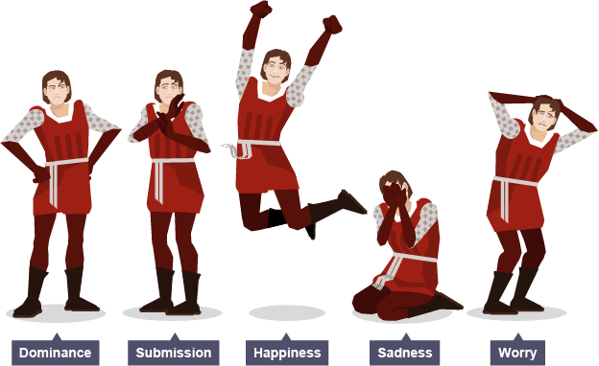

Slide 5
Positions of Body Language

Slide 6
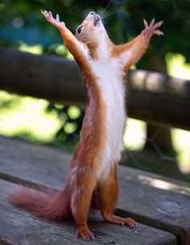
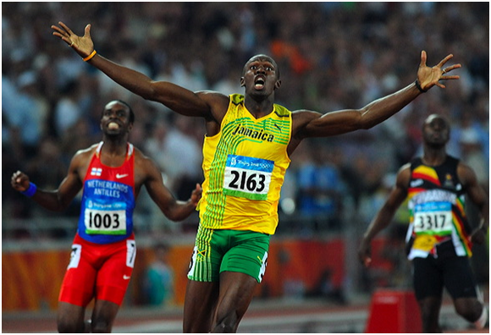
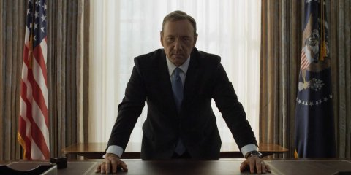
Positions of Power
Expanding of the body
Hands, neck, head raised
Open and commanding

Slide 7
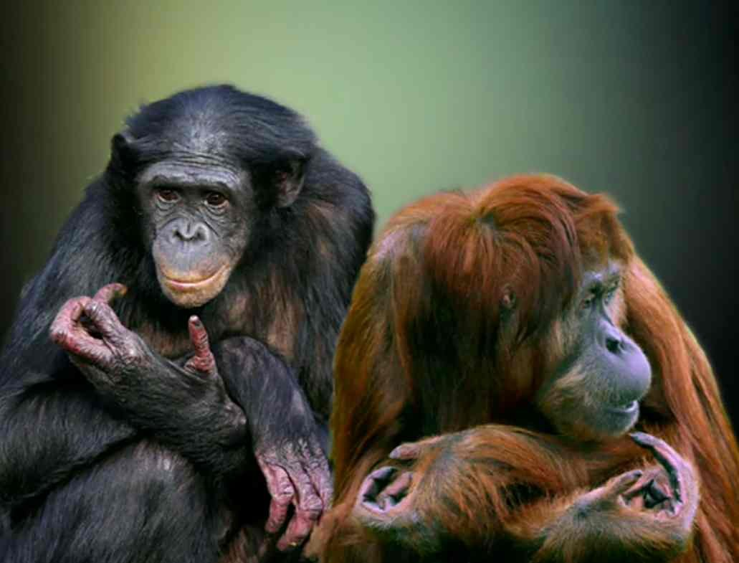
Positions of Powerless
Sunken posture
Arms hiding face, body
Back hunched

Slide 8
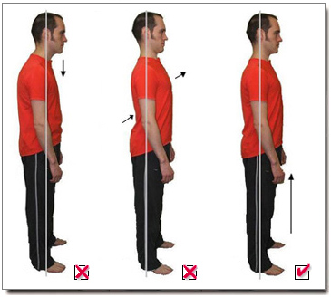
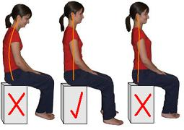
Proper Stage Posture
N eutral
O pen
D efined
S trong

Slide 9
Can you match your partner’s gestures?

Slide 10
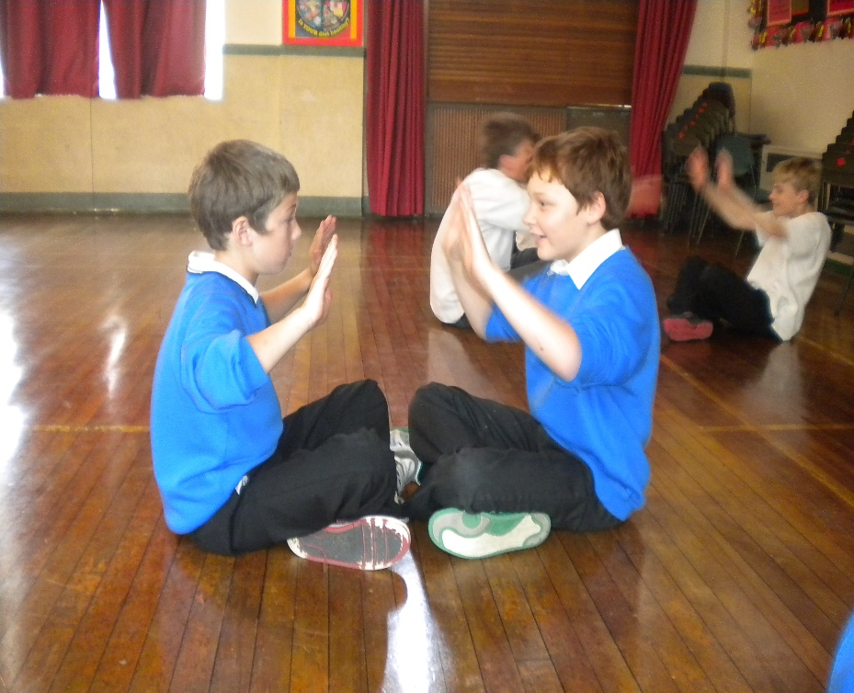
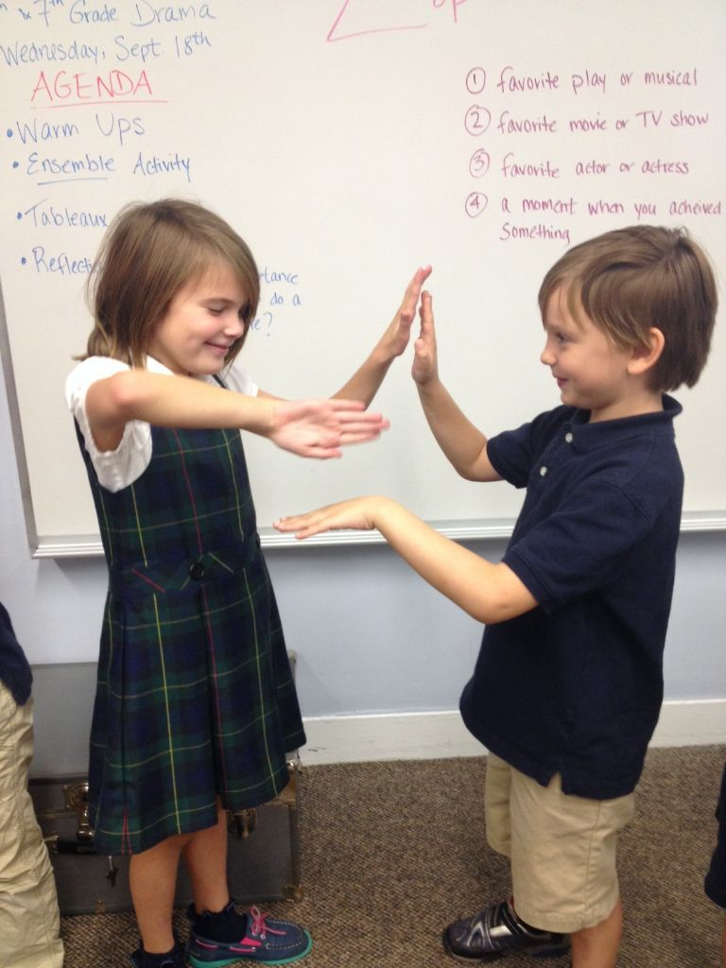
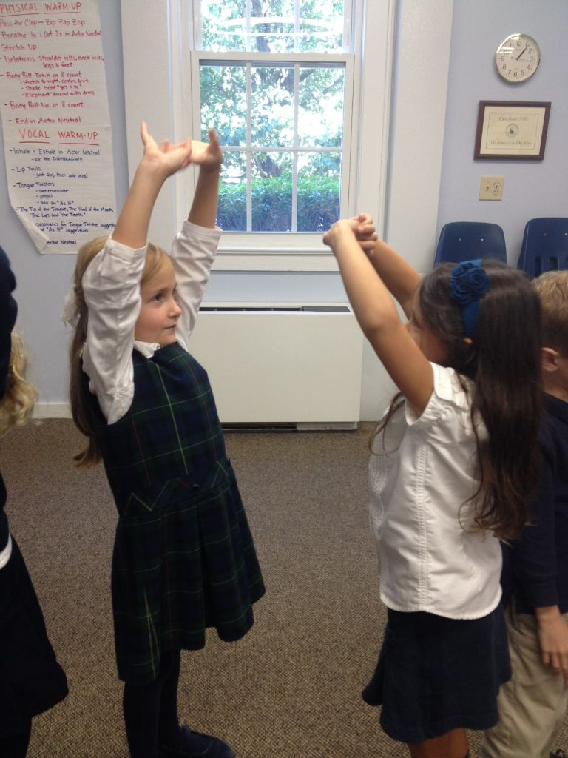
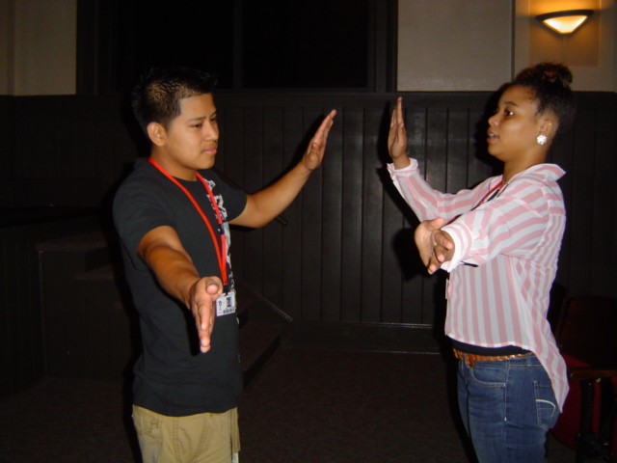
Slow Motion Unison

Slide 11
Pat your head
Wave hello
Brush Your Teeth
Drink some juice
Drive a car
Write your name

Slide 12
Bus Stop
Teacher will give instructions
How old do you think he is? o How did you know that? o What did he do to convey this? o Do you think he was happy about where he was going? Why? o Is there anything he could have done to make his choices clearer?

Slide 13
Facial Expressions
Using facial expressions allows the audience to connect to…
Feeling
Motivation
Intent
Mood

Slide 14
Using space!
Project body language by the way you stand and move.
You should claim the Space!

