Slide 1
Spanish Speaking Countries
Where can I use this language?

Slide 2
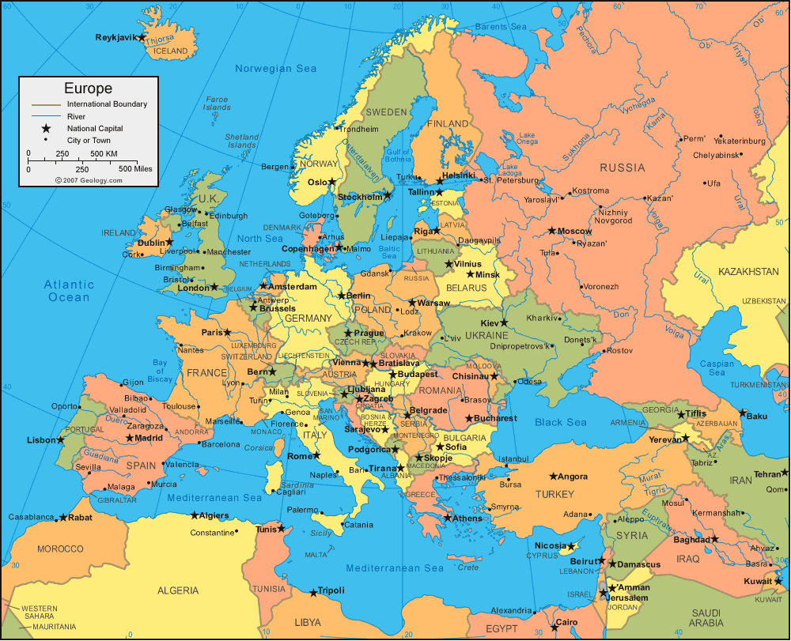
Europe
1. Spain

Slide 3

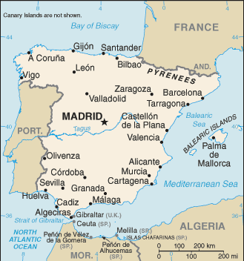
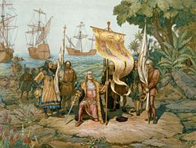
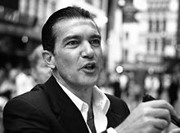
Spain
Capital: Madrid
Where Spanish language originated.
Thanks to Columbus,
was THE world power
of the 16th & 17th
centuries.
Antonio Banderas

Slide 4
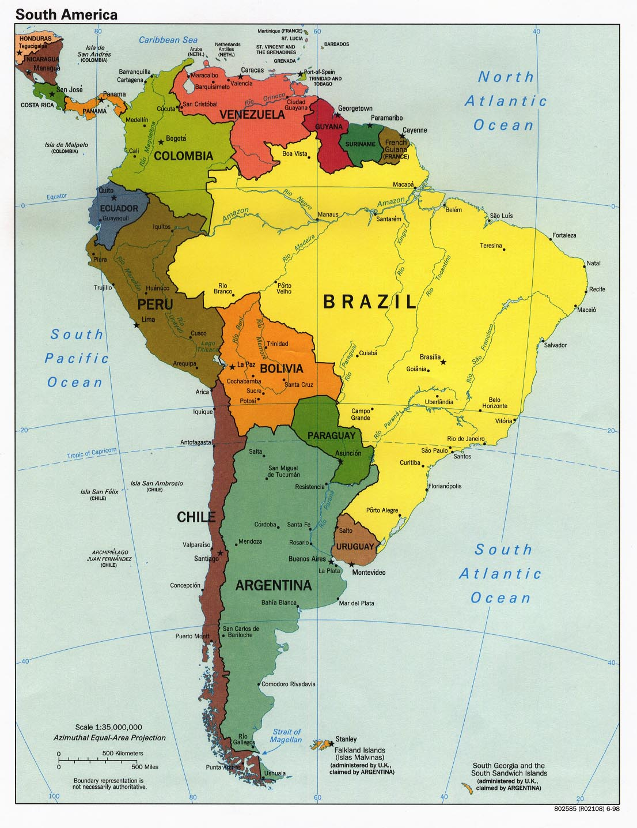
South America
9. Venezuela
2. Columbia
3. Ecuador
4. Peru
5. Bolivia
6. Chile
10. Uruguay
7. Paraguay
8. Argentina

Slide 5

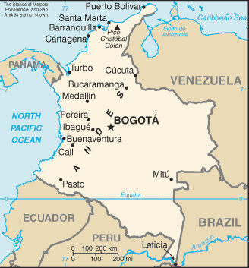
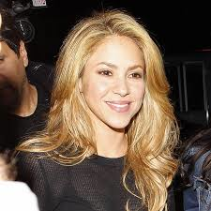
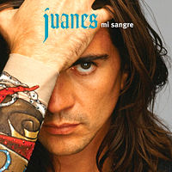
Columbia
Capital: Bogota
Named after Christopher Columbus.
Home of Shakira
& Juanes.

Slide 6

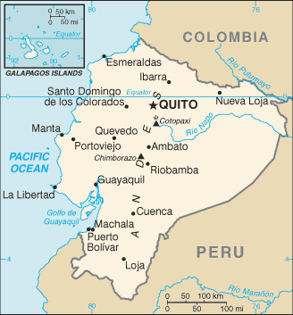

Ecuador
Capital: Quito
Name means Equator, which passes through the country
Country of the
Galapagos Islands.

Slide 7

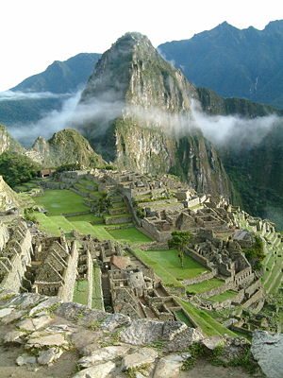
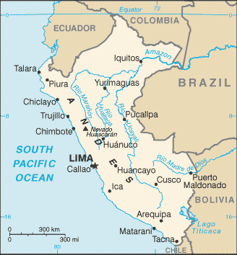

Peru
Capital: Lima
Capital of the Inca Empire.
Home of the ruins at
Machu Picchu.
Setting for newest
Indiana Jones movie.

Slide 8
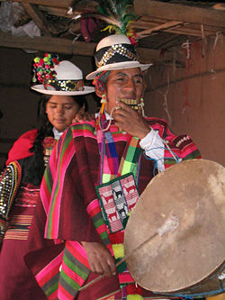

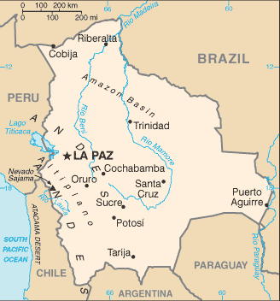
Bolivia
Capital: La Paz*
Named after S. American hero Simon Bolivar.
Home of Lake Titicaca
and Lake Poopo.
* Sucre is constitutional and judicial capital.

Slide 9

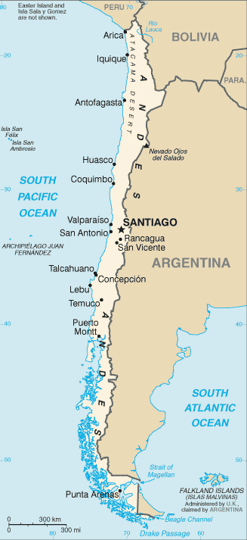
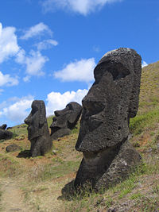
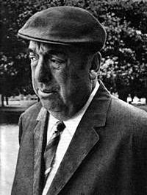
Chile
Capital: Santiago
Easter Island off coast.
Country of
Nobel Prize
poet Pablo
Neruda.

Slide 10
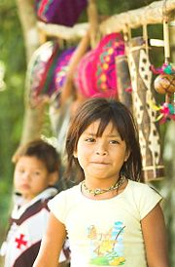

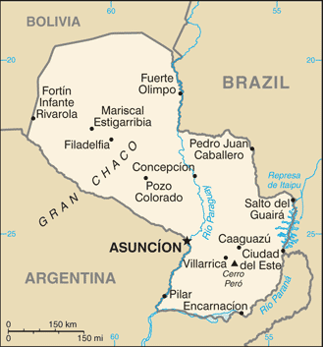
Paraguay
Capital: Asuncion
Rich Guarani Indian culture.
94% of the population
speaks Guarani. Only
75% speak Spanish.

Slide 11

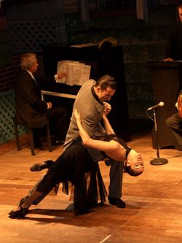
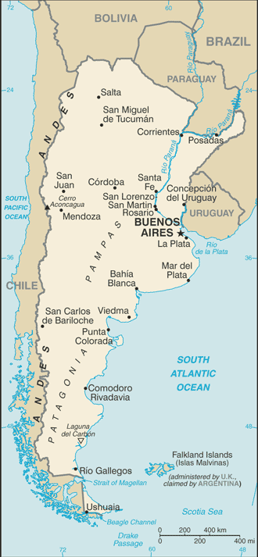
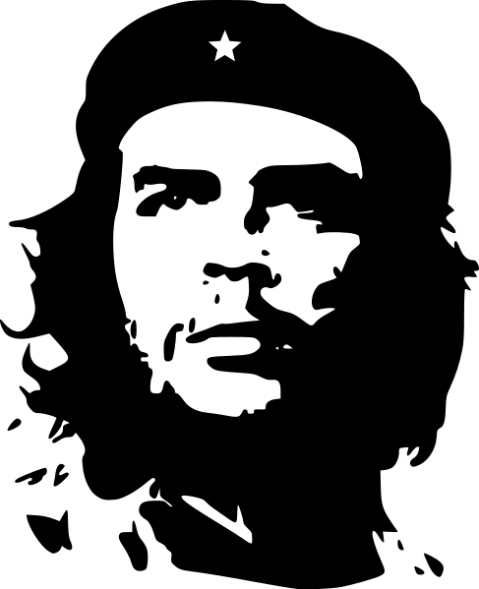

Argentina
Capital: Buenos Aires
Origin of the Tango.
Famous Argentines:
Evita & Che Guevara

Slide 12

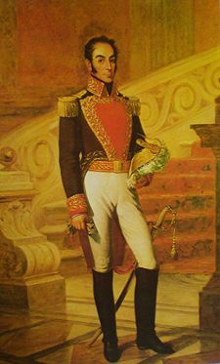
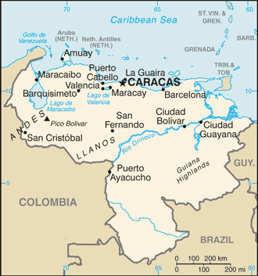
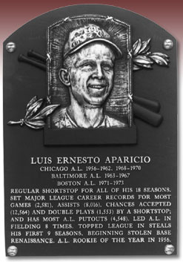
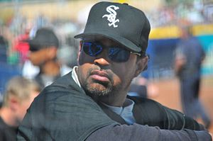
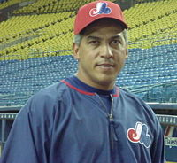
Venezuela
Capital: Caracas
Home of great S.
American liberator
Simon Bolivar.
Many famous baseball
players: Ozzie Guillen,
Andres Galaraga, and
H.O.F. Luis Aparicio

Slide 13

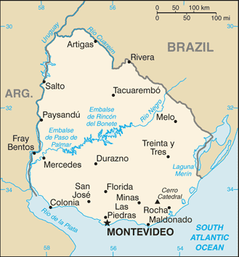
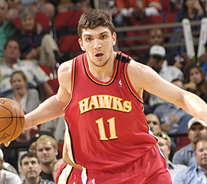
Uruguay
Capital: Montevideo
Very modern and
developed country.
Esteban Batista: First
Uruguayan NBA player.

Slide 14
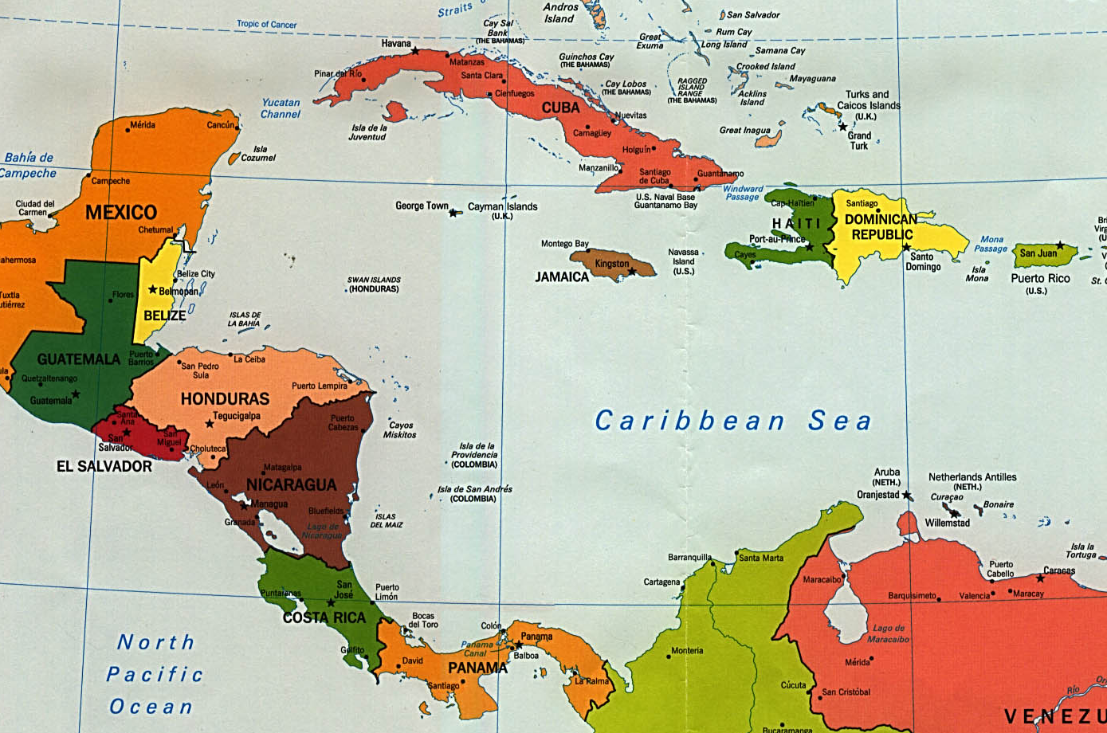
Central America
The Caribbean
18. Cuba
11. Guatemala
19. Dominican Republic
12. Belize
20. Puerto Rico
13. El Salvador
14. Honduras
15. Nicaragua
16. Costa Rica
17. Panama

Slide 15

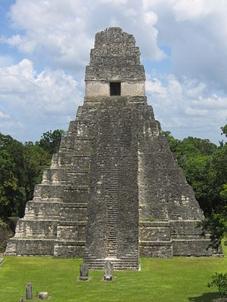
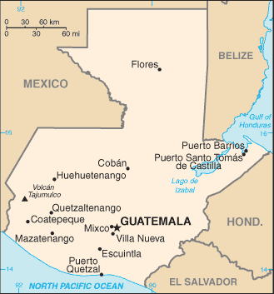
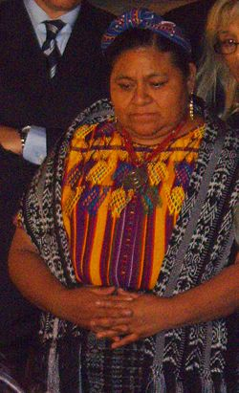
Guatemala
Capital: Guatemala City
Tikal: ancient
Mayan ruins.
Rigoberta Menchu:
Nobel Peace Prize 1992

Slide 16

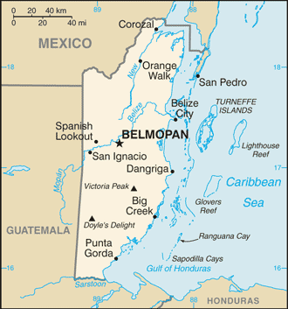
Belize
Capital: Belmopan
English is the “official” language. More people speak Spanish.
Former British Colony
now a British
Commonwealth

Slide 17

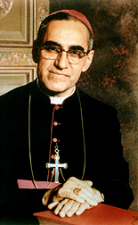
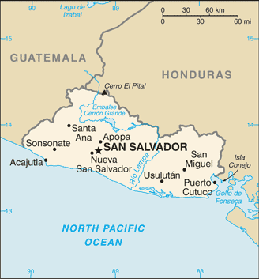
El Salvador
Capital: San Salvador
Martyred civil-rights
activist Archbishop Oscar Romero.
Name means
“The Savior”

Slide 18


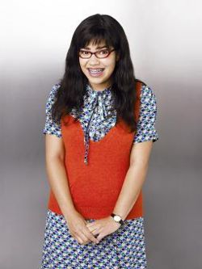
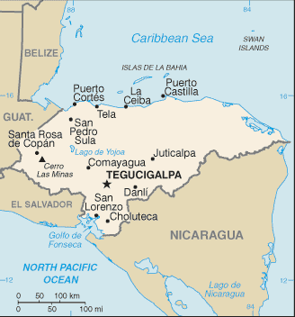
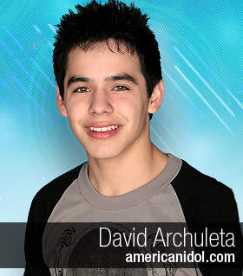
Honduras
Capital: Tegucigalpa
Famous Honduran Americans:
- Carlos Mencia (born in Honduras).
- David Archuleta (Honduran mom).
- America Ferrera (Honduran parents).

Slide 19

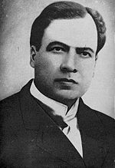
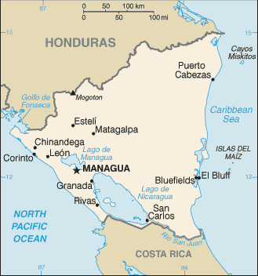
Nicaragua
Capital: Managua
Famous author/poet Reuben Dario
Iran/Contra scandal
in U.S. linked to
funding Nicaragua’s
Sandanistas mid 1980’s

Slide 20

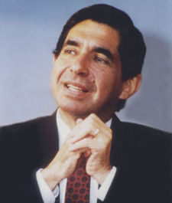
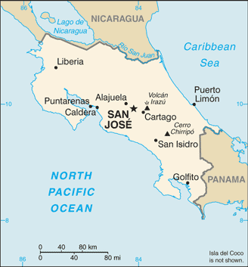

Costa Rica
Capital: San Jose
President Oscar Arias Sanchez
won Nobel Peace Prize in 1987
Beautiful rainforests and
Eco-tourism.

Slide 21

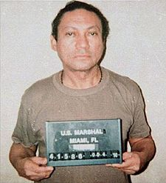
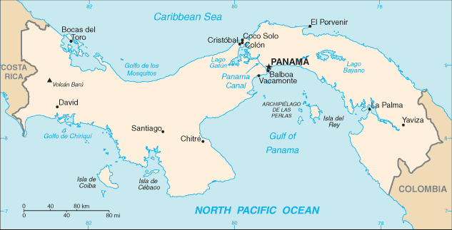
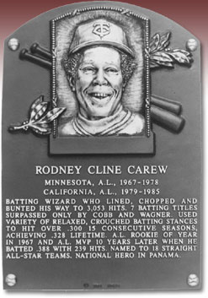
Panama
Capital: Panama City
Panama Canal links Atlantic and Pacific
U.S. invaded in 1989 to capture Manuel Noriega
Baseball H.O.F. Rod Carew

Slide 22

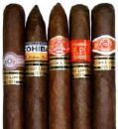
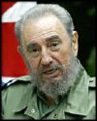
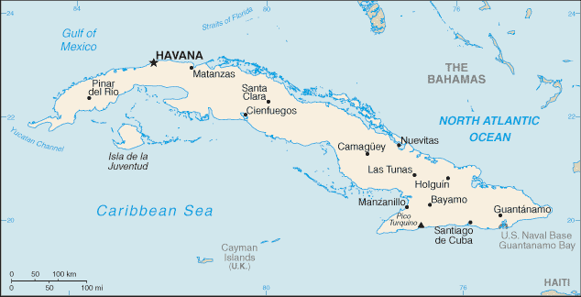
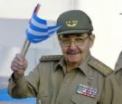
Cuba
Capital: Havana
World famous for their cigars.
Communist dictator Fidel Castro has been in power since 1959. Currently his brother Raul is the “official” head of state.
Fidel
Raul

Slide 23

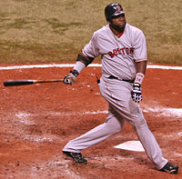


Dominican Republic
Capital: Santo Domingo
Baseball is most popular sport. Many MLB stars came from the Dominican Republic including: David (Big Papi) Ortiz, Sammy Sosa and Albert Pujols.
Island shares a border with
French speaking Haiti.

Slide 24



Puerto Rico
Capital: San Juan
Commonwealth of the United States. Puerto Ricans are granted U.S. citizenship.
One of the last Spanish colonies in the Americas. (1898)
Home of Ricky Martin (Livin’ La Vida Loca)

Slide 25

North America
22. The United States ??
According to the 2000 census, there are 28,100,000 (that’s 28 million!!!) Spanish speakers in the United States.
Recent data shows the U.S. as the 5th largest Spanish speaking country in the world.
You Are Here
21. Mexico

Slide 26





Mexico
Capital: Mexico City
Mexican cuisine mixture of European and indigenous ingredients. Authentic Mexican food differs a bit from Taco Bell.
Capital of the Aztec Empire.
Traditional music:
Mariachi

Slide 27


United States
Capital: Washington D.C.
Effects of Spanish on U.S.:
Spanish speakers: Largest growing people group in US.
Almost 100,000
speakers in Iowa
according to 2006
US Census Bureau
data.

Slide 28
So Why Are You Learning Spanish?

